Slide 1
CHIT CHAT WebApp
Team
Nishant Pandey
Tripuresh Tripathi
Hansi Saxena

Slide 2
Content
Introduction
Hardware specification
Software requirements
Front end
Back end
System architecture
Conceptual Use case
How we different
Future Scope and conclusion

Slide 3
Introduction
This project is a multi user real-time chatting WebApp which is more privacy driven.
User can connect to the server and make rooms and start chatting with their friends.
The webapp can run on any device pc or phone

Slide 4
Hardware specification
Any device Pc or Phone
Web browser

Slide 5
Software requirements
Windows 10
Visual studio code
Framework and Libraries of JavaScript like react, socket and node
Any Web browser

Slide 6
Front end
Html
CSS
React

Slide 7
Back end
Node JS
Socket

Slide 8
System Architecture
User 2
WebApp
User 1
User 3
User 4

Slide 9
Conceptual Use Case
View messages
Send messages
Invite people
Make Room
Room Host
Room Client
Close Room

Slide 10
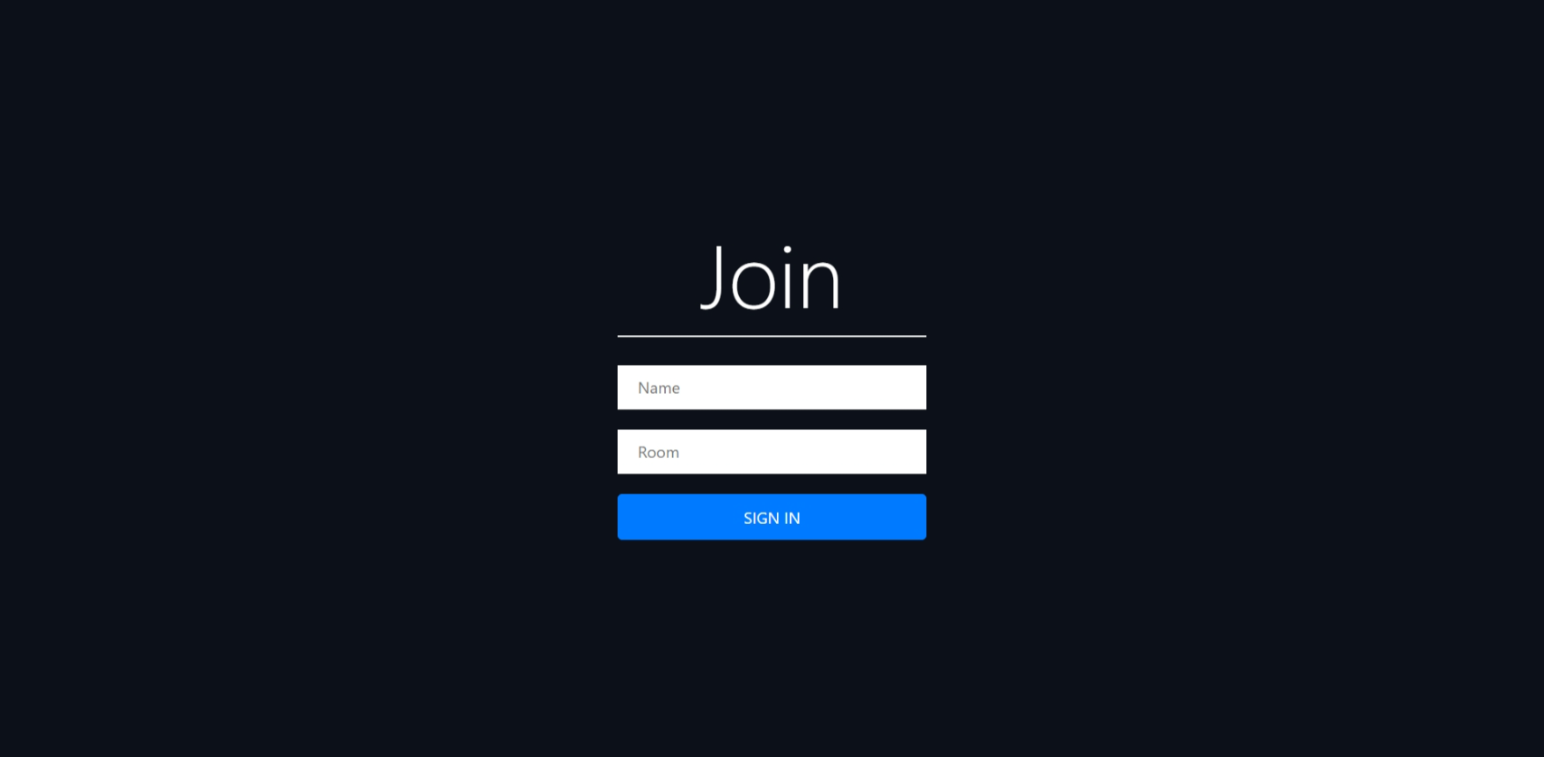
Home page

Slide 11
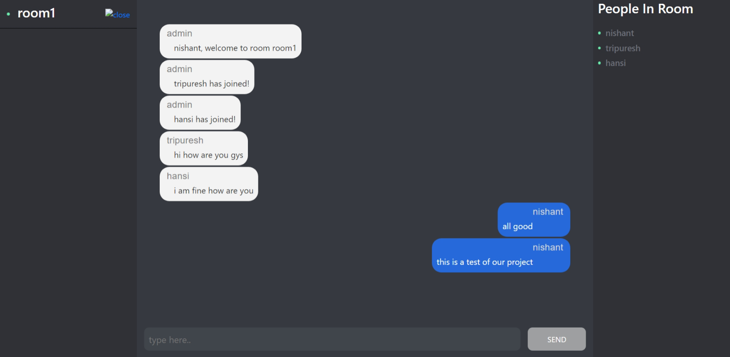
Chat Page

Slide 12
How we are different
There are many chatting application that provide the same benefit like ours but the thing that makes us different is privacy. In most of the applications data of user are tracked and used for the benefit of the company, examples are Facebook and Google.
Here since there is no storage of data of the user and all of it is deleted as soon as the room is closed there is no tracking of data. A person can be fully anonymous as there is no signing required.

Slide 13
Future Scope
We will upgrade our application with option of voice chatting that will give it more functionality and convenience to the user.
Adding ability to send photos and videos will also be our future agenda.

Slide 14
Thankyou

